Slide 1


Enhancing your JavaScript with TypeScript
An Interactive Journey with Matt DelBrocco as your Guide
Notes:
Make sure to start the zoom call so we can get Brian listening in (and make sure he can see the screen).

Slide 2
A Quick Overview
What is TypeScript?
01
TypeScript Details (Types and such)
03
Getting Started Demos
04
Practical Code Examples
05
Should We Use It?
02

Slide 3

Goals of this presentation
Demystify TypeScript for the entire team
Evaluate pros/cons
Discuss some practical examples and application
Practice my technical speaking/presenting skills!
Warning – there are some memes in this presentation
Notes:
Before leaving slide: Yep, it took til only the third slide for the memes to start. Here we go!

Slide 4
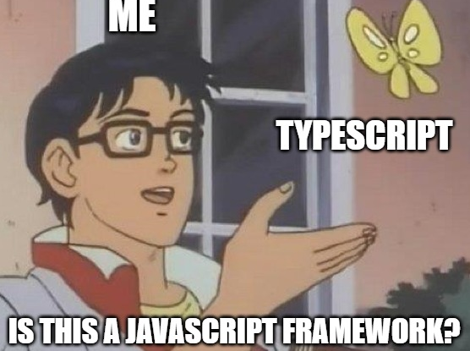
What is everyone’s TypeScript Knowledge?
Heard of it before?
How it relates to JavaScript?
Pros/Cons?
Notes:
Hopefully you don’t know *all* the answers to all these questions, or this presentation might be a bit boring for you..
TypeScript -> tsc (compiler) -> JavaScript

Slide 5
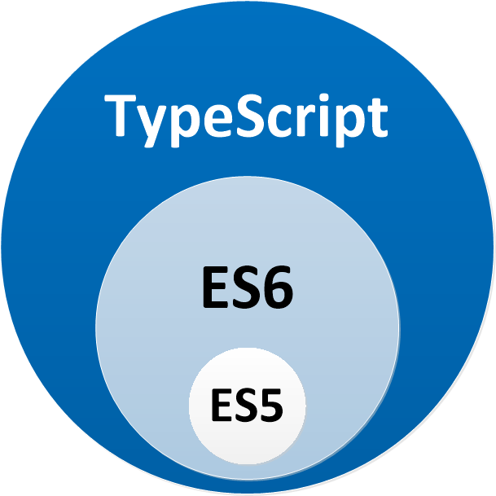
Syntactical Superset of Javascript (ECMAScript)
Notes:
TypeScript is a typed superset of JavaScript that compiles to plain JavaScript - any browser, host, OS. Open Source. (https://www.typescriptlang.org/)
Easy to slowly adopt because TS is a superset. Adds optional static typing to the language.
It’s open source, but developed and maintained by Microsoft.
A note about ECMAScript (European Computer Manufacturer's Association) – You might hear people, myself included, use a mix of “ES6” and “Javascript”. They’re roughly equivalent from a practical standpoint, but technically ECMAScript is the scripting language specification, and Javascript is a language based on that spec. Fun fact, JScript is another language based on the ECMAScript spec. They keep making new versions each year with extra syntax. ES5 is fully supported in all modern browsers (https://www.w3schools.com/js/js_versions.asp)
Chrome supports ES7 as of May 2018, while Internet Explorer only supports ES5, for example.

Slide 6
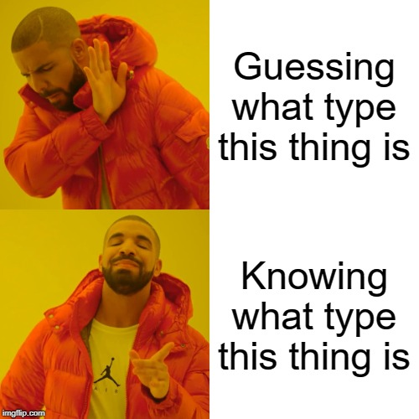
Is it worth?
Totally, it’s the bees knees!
Type safety / Compile-time errors
Improvements to Intellisense / Autocomplete / Code Navigation (you get these to some extent in VSCode with just JS, to be fair)
More readable code, usually
JS files can be renamed to TS files and typed gradually (unless --noImplicitAny flag is enabled in tsconfig)
Notes:
1) Can sometimes be annoying to get “more errors”, but it’s better to know sooner and helps catch bugs.
2) Better development experience
Pro #2 note – Sami and I had an example where we did a rename. First without TS typings, it didn’t pick up all usages. After we added typings and tried again, it renamed all usages
3) I suppose this is debatable
4) Incremental adoption
Many of these points are from my general knowledge over the years, but I got some additional ideas from https://stackoverflow.com/questions/12694530/what-is-typescript-and-why-would-i-use-it-in-place-of-javascript

Slide 7
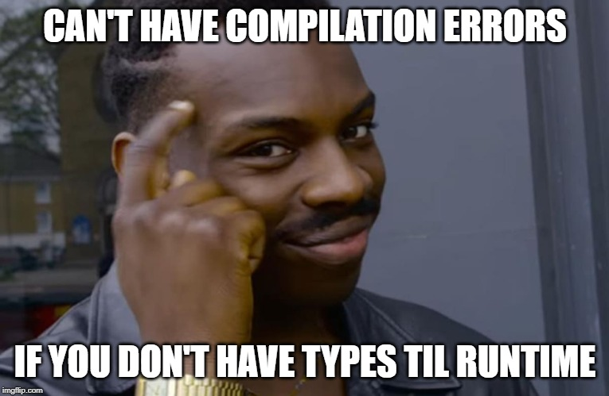
Is it worth?
I dunno, it has downsides…
Higher learning curve
More code (type defs)
Takes time to add types
More time to set up (but I've already done this)
More time to build (though with create-react-app & react-scripts, our build & dev commands remain the same)
Notes:
“No Free Lunch” – one of my profs in college.
4) By this I mean time spent adding it to the build chain
5) By this I mean you need to compile typescript when you want to run

Slide 8
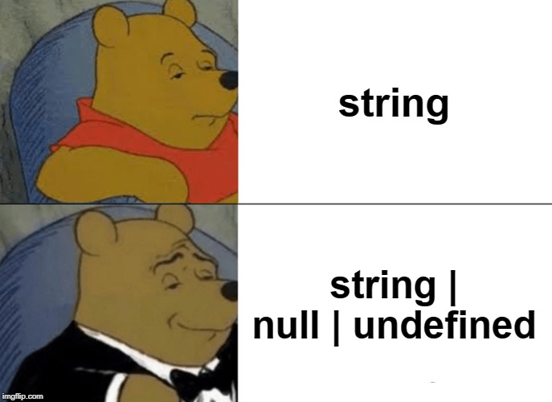
Tell me more about these Types…
Docs: http://www.typescriptlang.org/docs/handbook/basic-types.html
Shares types you likely know from JavaScript:
Boolean
Number
String
Object (non-primitive) – {}
Array (non-primitive) – []
Null and Undefined – special types that are not very useful alone. All other types can have these as values (if --strictNullChecks flag is off… otherwise, you explicitly say if you want a nullable string by making the type a union type: string | null | undefined)
Union Types
Notes:
Note: Primitives are immutable, are not objects, and have no methods.
Null & Undefined – you probably recognize from JavaScript
Union Types - https://www.typescriptlang.org/docs/handbook/advanced-types.html#union-types
Idea – when I’m presenting this info, how about I show a code example of each one?
https://www.typescriptlang.org/docs/handbook/advanced-types.html#nullable-types

Slide 9

Types introduced by TypeScript
Tuple (see example in docs)
Enum - helps code readability, but also has some perks
String or Numeric Literal Types can be used instead
Any - the fallback if we don't know the type (dynamic) or want to opt out for some reason – flexibility!
Allows us to work with existing JS, gradually move to fully-typed TS.
Void - absence of having any type at all, typically seen as the return type of functions that don't return any value, e.g. onButtonClick: () => void;
Never - the type of values that never occur. Niche use case.
Notes:
Now before you head out upon seeing that there are types such as “Never” and “Void”, lemme explain…
Tuple: http://www.typescriptlang.org/docs/handbook/basic-types.html#tuple
Enum string/number based (https://www.typescriptlang.org/docs/handbook/enums.html#union-enums-and-enum-member-types) & String/Number Literal Types – great examples in the docs of how these are helpful:
https://www.typescriptlang.org/docs/handbook/advanced-types.html#string-literal-types
https://www.typescriptlang.org/docs/handbook/advanced-types.html#numeric-literal-types
Never: http://www.typescriptlang.org/docs/handbook/basic-types.html#never

Slide 10
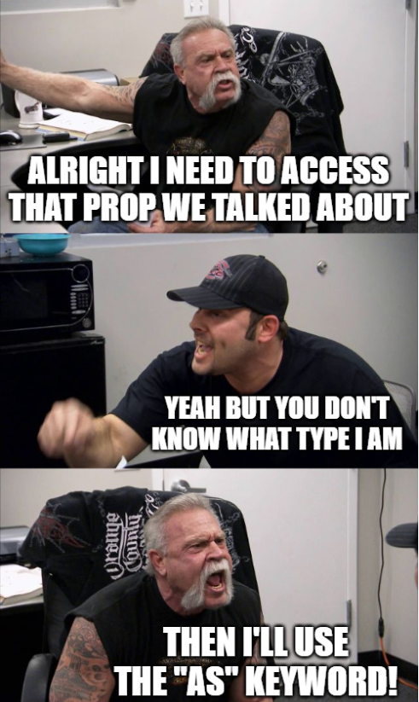
For uncertainty in types: Type Checks & Assertions
(<string>someValue).length // option 1
(someValue as string).length // option 2
if(someValue as string)
return someValue.length;
else
eturn 0;
Notes:
May be worth noting a potential gotcha – sometimes you can have a compilation error related to your types. For example, you’re consuming some external object or api that you don’t have control over (e.g. jQuery) or something you simply haven’t typed. YOU know it has a prop called xyz of type string, but the TS compiler does not. Solution – type assertion!
Cool functionality – after you do a type check, the compiler treats the field as that type while within that scope.

Slide 11
TS Demo: Getting Started
Code can be found in this repo: https://github.com/mdelbrocco-od/typescript-samples
TypeScript getting started (not specific to any JavaScript framework): https://www.typescriptlang.org/docs/handbook/typescript-in-5-minutes.html
Choose your own adventure: You have two options to “get TypeScript”
Easy mode: Open up Visual Studio. As of VS 2015 Update 3, includes TypeScript by default!
Deeper dive: Command Line! npm i -g typescript --save-dev / yarn global add typescript –dev
Compile with tsc greeter.ts ("TypeScript Compile")
Notes:
1) Ask: Everyone familiar with package managers - npm / yarn? For me, this was a big thing that was always brushed over at conference talks I went to as a junior programmer. This made things seem way more complex to me!
2) Demo: Visual Studio handles so much of this automatically… for example, for this simple “greeter” demo, I was able to simply pop open the folder in VS, even without a .sln file, it still compiled js -> ts on save!
3) Demo: Visual Studio Code (can use the terminal in here instead of powershell)
4) Installing globally is putting it at the user level – e.g. it’s placed in C:/Users/mdelbrocco/… slightly different places depending on if you used npm or yarn.
5) Typically you won’t be specifying a file like this, we’re just doing it because we don’t have a tsconfig yet. More on that, next slide.

Slide 12
How does TypeScript work? (A peek behind the curtain)
Installing typescript gives us the tsc command, stands for TypeScript Compile.
tsconfig.json file - created by running tsc --init, controls how TS compilation works. Some startup kits (e.g. NextJS, Gatsby, CRA) create this for you.
More on tsconfig: https://www.typescriptlang.org/docs/handbook/tsconfig-json.html
Later, can install more type definitions (npm i --save-dev @types/node @types/react @types/react-dom @types/jest)
Can also declare your own types
By convention, “.d.ts” files provide type information about an API that’s written in Javascript
.js.map files
Notes:
1) Running tsc with no arguments will spit out a bunch of information. Most of this would be handled by tsconfig.json.
2) .js.map files -> also used when minifying js, they’re just a way to get back to the corresponding location in the original source code (so, going from js back to ts source, line numbers)

Slide 13
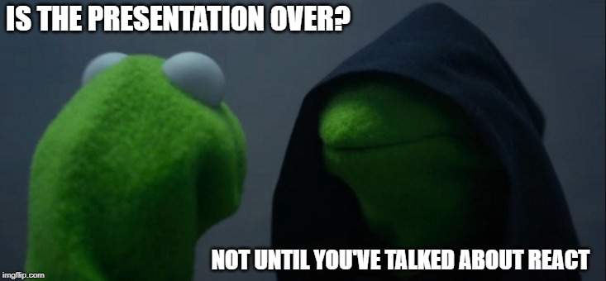

Slide 14
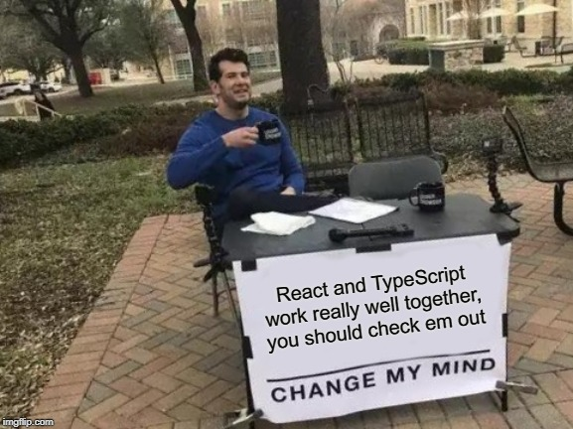
Let’s Add React to the Mix!!!
Up until this point, the presentation has been JS framework agnostic, unless I slipped up and started talking about React.
Notes:
Any real examples I show would be from Atlas, where we’re using TypeScript and React together, so let get a quick intro to React. I promise it’ll be quick and relatively painless.

Slide 15
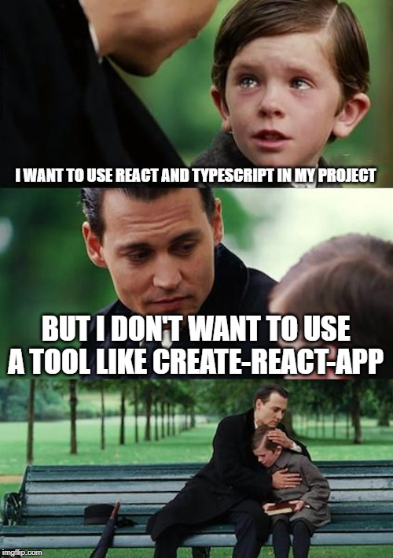
TS Demo: with React
TypeScript + React getting started with Create React App: https://create-react-app.dev/docs/adding-typescript/
If creating a new CRA project: npm create-react-app your-app-name-here --template typescript
Can also add TS to an existing CRA project (what Atlas did): npm i -g typescript --save-dev / yarn add typescript --dev
Or; Manual setup of React & Webpack: https://www.typescriptlang.org/docs/handbook/react-&-webpack.html
webpack.config.js
Outside the scope of this presentation
Notes:
Back to my code repo, follow the README steps. Final result on the branch cra-done.
For now just demo with CRA, but point out that manual is an option if you don’t want to treat this all as a black box (and you want to avoid extra unneeded dependencies)
CRA is a great way to get started quickly with a project configured with react, unit testing (jest), typescript, etc. Potential downside is it adds more than you may need.
Don’t worry about this too much: Webpack is an asset bundler (CRA configures that too)

Slide 16
Real Life Examples for Real Life Devs
Some practical code examples from our Atlas CS Site
Knowing what is expected on props for a functional component
Really helpful for the caller of that component
Example: FilterPanel.tsx
Makes it pretty obvious to you when you have an unused prop or typo
Example: RadioInputs.tsx
Calling code was passing in a “Name” value even though it didn’t have to
Types can help a dev keep their sanity
Example: me when working in ReceivedAssetsPage.tsx, ReceivedAssetsTable.tsx, etc.
Follow the flow down from the page component to the table to the pager
Notes:
Can mention ability to find usages and navigate between variables/components/props, although I think we’d have that anyway without TS.
1) In general, knowing what you expect on props (React specific, but still), is very helpful)
2) Show how adding “name: string” to the props interface causes compilation error at call site, and vice versa
2b) I forget where but I found a typo in a prop name
3) Helpful to define things like FilterState, PagerState, QueryParams, etc.
3b) Check out how I call the ReceivedAssetsTable – props interface on THAT component makes it easy for me to know what to pass down, although sometimes I develop bottom -> up.
3c) Highlight PagerProps, pretty clean example of a nice interface.

Slide 17
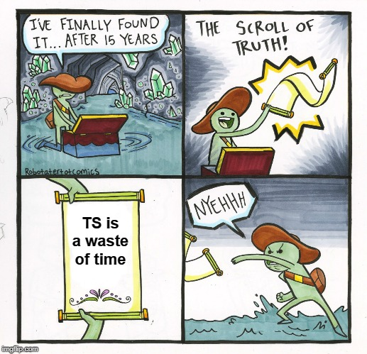
What Next?
Consider TS for any user-facing projects moving forward that have JavaScript!
…but don't necessarily auto include. Think about whether the tradeoffs are worth it!
Notes:
I do not advocate blindly adopting TypeScript everywhere we can… though I do lean towards it.

Slide 18
Additional Resources
Typescript GitHub repo, docs: https://github.com/microsoft/TypeScript
TypeScript Basic Types: https://www.typescriptlang.org/docs/handbook/basic-types.html
Samples for future reading (some used in this presentation!): https://github.com/microsoft/TypeScriptSamples
TypeScript Do's and Don't's: https://www.typescriptlang.org/docs/handbook/declaration-files/do-s-and-don-ts.html#general-types
Notes:
1) The actual source code for TypeScript, if you REALLY want a deep dive into this topic
2) We went over most of these, but here it is for reference
3) Most of these will require a little setup to get running. My favorite was the battleship ripoff.
Dos & Donts (4): there are some things in here I knew, but also some interesting nuggets of info that I did not know.

Slide 19
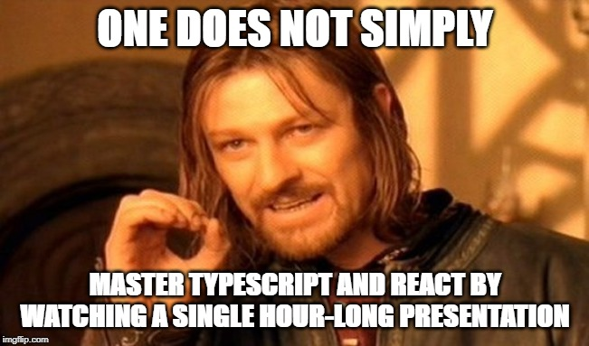
Additional Resources, React Specific
React-typescript-cheatsheet: https://github.com/typescript-cheatsheets/react-typescript-cheatsheet#reacttypescript-cheatsheets
TypeScript React Starter https://github.com/Microsoft/TypeScript-React-Starter/blob/master/tsconfig.json
Notes:
Best practices and copy-pastable examples, but kinda aimed at experienced React devs who want to get started with TypeScript.
This is just a sample tsconfig.json

Slide 20

Thank You! Questions or Feedback?
Notes:
Questions? Comments? Feedback? Anything you were hoping I’d go over that I didn’t? Or perhaps something I went too far into that I probably didn’t need to?

